Slide 1
Counting
Chapter 6
With Question/Answer Animations
© 2019 McGraw-Hill Education. All rights reserved. Authorized only for instructor use in the classroom. No reproduction or further distribution permitted without the prior written consent of McGraw-Hill Education.

Slide 2
Chapter Summary
The Basics of Counting
The Pigeonhole Principle
Permutations and Combinations
Binomial Coefficients and Identities
Generalized Permutations and Combinations
Generating Permutations and Combinations (not yet included in overheads)

Slide 3
The Basics of Counting
Section 6.1

Slide 4
Section Summary 1
The Product Rule
The Sum Rule
The Subtraction Rule
The Division Rule
Examples, Examples, and Examples
Tree Diagrams

Slide 5
Basic Counting Principles:
The Product Rule
The Product Rule: A procedure can be broken down into a sequence of two tasks. There are n₁ ways to do the first task and n₂ ways to do the second task. Then there are n₁∙n₂ ways to do the procedure.
Example: How many bit strings of length seven are there?
Solution: Since each of the seven bits is either a 0 or a 1, the answer is 2⁷ = 128.

Slide 6
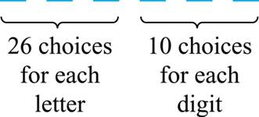
The Product Rule
Example: How many different license plates can be made if each plate contains a sequence of three uppercase English letters followed by three digits?
Solution: By the product rule,
there are 26 ∙ 26 ∙ 26 ∙ 10 ∙ 10 ∙ 10 = 17,576,000 different possible license plates.
Jump to long description

Slide 7
Counting Functions
Counting Functions: How many functions are there from a set
with m elements to a set with n elements?
Solution: Since a function represents a choice of one of the n elements of the codomain for each of the m elements in the domain, the product rule tells us that there are n ∙ n ∙ ∙ ∙ n = n^{m}
such functions.
Counting One-to-One Functions: How many one-to-one
functions are there from a set with m elements to one with n elements?
Solution: Suppose the elements in the domain are
a₁, a₂,…, a_{m}. There are n ways to choose the value of a₁ and n−1 ways to choose a₂, etc. The product rule tells us that there are n(n−1) (n−2)∙∙∙(n−m +1) such functions.

Slide 8
Telephone Numbering Plan
Example: The North American numbering plan (NANP) specifies that a telephone number consists of 10 digits, consisting of a three-digit area code, a three-digit office code, and a four-digit station code. There are some restrictions on the digits.
  Let X denote a digit from 0 through 9.
  Let N denote a digit from 2 through 9.
  Let Y denote a digit that is 0 or 1.
  In the old plan (in use in the 1960s) the format was NYX-NNX-XXXX.
  In the new plan, the format is NXX-NXX-XXXX.
How many different telephone numbers are possible under the old plan and the new plan?
Solution: Use the Product Rule.
  There are 8 ∙2 ∙10 = 160 area codes with the format NYX.
  There are 8 ∙10 ∙10 = 800 area codes with the format NXX.
  There are 8 ∙8 ∙10 = 640 office codes with the format NNX.
  There are 10 ∙10 ∙10 ∙10 = 10,000 station codes with the format XXXX.
Number of old plan telephone numbers: 160 ∙640 ∙10,000 = 1,024,000,000.
Number of new plan telephone numbers: 800 ∙800 ∙10,000 = 6,400,000,000.

Slide 9
Counting Subsets of a Finite Set
Counting Subsets of a Finite Set: Use the product rule to show that the number of different subsets of a finite set S is 2^{|S|}. (In Section 5.1, mathematical induction was used to prove this same result.)
Solution: When the elements of S are listed in an arbitrary order, there is a one-to-one correspondence between subsets of S and bit strings of length |S|. When the ith element is in the subset, the bit string has a 1 in the ith position and a 0 otherwise.
By the product rule, there are 2^{|S|} such bit strings, and therefore 2^{|S|} subsets.

Slide 10
Product Rule in Terms of Sets
If A₁, A₂, … , A_{m} are finite sets, then the number of elements in the Cartesian product of these sets is the product of the number of elements of each set.
The task of choosing an element in the Cartesian product A₁ ⨉ A₂ ⨉ ∙∙∙ ⨉ A_{m} is done by choosing an element in A₁, an element in A₂ , …, and an element
in A_{m}.
By the product rule, it follows that:

Slide 11
DNA and Genomes
A gene is a segment of a DNA molecule that encodes a particular protein and the entirety of genetic information of an organism is called its genome.
DNA molecules consist of two strands of blocks known as nucleotides. Each nucleotide is composed of bases: adenine (A), cytosine (C), guanine (G), or thymine (T).
The DNA of bacteria has between 10⁵ and 10⁷ links (one of the four bases). Mammals have between 10⁸ and 10¹⁰ links. So, by the product rule there are at least 4¹⁰⁵ different sequences of bases in the DNA of bacteria and 4¹⁰⁸ different sequences of bases in the DNA of mammals.
The human genome includes approximately 23,000 genes, each with 1,000 or more links.
Biologists, mathematicians, and computer scientists all work on determining the DNA sequence (genome) of different organisms.

Slide 12
Basic Counting Principles:
The Sum Rule
The Sum Rule: If a task can be done either in one of n₁ ways or in one of n₂, where none of the set of n₁ ways is the same as any of the n₂ ways, then there are n₁ + n₂ ways to do the task.
Example: The mathematics department must choose either a student or a faculty member as a representative for a university committee. How many choices are there for this representative if there are 37 members of the mathematics faculty and 83 mathematics majors and no one is both a faculty member and a student.
Solution: By the sum rule it follows that there are
37 + 83 = 120 possible ways to pick a representative.

Slide 13
The Sum Rule in terms of sets.
The sum rule can be phrased in terms of sets.
|A ∪ B|= |A| + |B| as long as A and B are disjoint sets.
Or more generally,
The case where the sets have elements in common will be discussed when we consider the subtraction rule and taken up fully in Chapter 8.

Slide 14
Combining the Sum and Product Rule
Example: Suppose statement labels in a programming language can be either a single letter or a letter followed by a digit. Find the number of possible labels.
Solution: Use the product rule.
26 + 26 ∙ 10 = 286

Slide 15
Counting Passwords
Combining the sum and product rule allows us to solve more complex problems.
Example: Each user on a computer system has a password, which is six to eight characters long, where each character is an uppercase letter or a digit. Each password must contain at least one digit. How many possible passwords are there?
Solution: Let P be the total number of passwords, and let P₆, P₇, and P₈ be the passwords of length 6, 7, and 8.
  By the sum rule P = P₆ + P₇ +P₈.
  To find each of P₆, P₇, and P₈ , we find the number of passwords of the specified length composed of letters and digits and subtract the number composed only of letters. We find that:
  P₆ = 36⁶ − 26⁶ =2,176,782,336 − 308,915,776 =1,867,866,560.
  P₇ = 36⁷ − 26⁷ =
  78,364,164,096 − 8,031,810,176 = 70,332,353,920.
  P₈ = 36⁸ − 26⁸ =
  2,821,109,907,456 − 208,827,064,576 =2,612,282,842,880.
  Consequently, P = P₆ + P₇ +P₈ = 2,684,483,063,360.

Slide 16
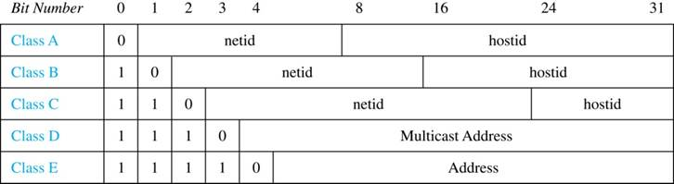
Internet Addresses
Version 4 of the Internet Protocol (IPv4) uses 32 bits.
Class A Addresses: used for the largest networks, a 0,followed by a 7-bit netid and a 24-bit hostid.
Class B Addresses: used for the medium-sized networks, a 10,followed by a 14-bit netid and a 16-bit hostid.
Class C Addresses: used for the smallest networks, a 110,followed by a 21-bit netid and a 8-bit hostid.
  Neither Class D nor Class E addresses are assigned as the address of a computer on the internet. Only Classes A, B, and C are available.
  1111111 is not available as the netid of a Class A network.
  Hostids consisting of all 0s and all 1s are not available in any network.
Jump to long description

Slide 17
Counting Internet Addresses
Example: How many different IPv4 addresses are available for computers on the internet?
Solution: Use both the sum and the product rule. Let x be the number of available addresses, and let x_{A}, x_{B}, and x_{C} denote the number of addresses for the respective classes.
  To find, x_{A}: 2⁷ − 1 = 127 netids. 2²⁴ − 2 = 16,777,214 hostids.
  x_{A} = 127∙ 16,777,214 = 2,130,706,178.
  To find, x_{B}: 2¹⁴ = 16,384 netids. 2¹⁶ − 2 = 16,534 hostids.
  x_{B} = 16,384 ∙ 16, 534 = 1,073,709,056.
  To find, x_{C}: 2²¹ = 2,097,152 netids. 2⁸ − 2 = 254 hostids.
  x_{C} = 2,097,152 ∙ 254 = 532,676,608.
  Hence, the total number of available IPv4 addresses is
  x = x_{A} + x_{B} + Xc
  = 2,130,706,178 + 1,073,709,056 + 532,676,608
  = 3, 737,091,842.
Not Enough Today !!
The newer IPv6 protocol solves the problem of too few addresses.

Slide 18
Basic Counting Principles:
Subtraction Rule
Subtraction Rule: If a task can be done either in one of n₁ ways or in one of n₂ ways, then the total number of ways to do the task is n₁ + n₂ minus the number of ways to do the task that are common to the two different ways.
Also known as, the principle of inclusion-exclusion:

Slide 19
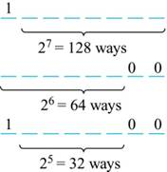
Counting Bit Strings
Example: How many bit strings of length eight either start with a 1 bit or end with the two bits 00?
Solution: Use the subtraction rule.
  Number of bit strings of length eight
  that start with a 1 bit: 2⁷ = 128
  Number of bit strings of length eight
  that end with bits 00: 2⁶ = 64
  Number of bit strings of length eight
  that start with a 1 bit and end with bits 00 : 2⁵ = 32
Hence, the number is 128 + 64 − 32 = 160.
Jump to long description

Slide 20
Basic Counting Principles: Division Rule
Division Rule: There are n/d ways to do a task if it can be done using a procedure that can be carried out in n ways, and for every way w, exactly d of the n ways correspond to way w.
Restated in terms of sets: If the finite set A is the union of n pairwise disjoint subsets each with d elements, then n = |A|/d.
In terms of functions: If f is a function from A to B, where both are finite sets, and for every value y ∈ B there are exactly d values x ∈ A such that f(x) = y, then |B| = |A|/d.
Example: How many ways are there to seat four people around a circular table, where two seatings are considered the same when each person has the same left and right neighbor?
Solution: Number the seats around the table from 1 to 4 proceeding clockwise. There are four ways to select the person for seat 1, 3 for seat 2, 2, for seat 3, and one way for seat 4. Thus there are 4! = 24 ways to order the four people. But since two seatings are the same when each person has the same left and right neighbor, for every choice for seat 1, we get the same seating.
Therefore, by the division rule, there are 24/4 = 6 different seating arrangements.

Slide 21
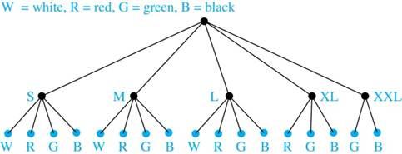
Tree Diagrams
Tree Diagrams: We can solve many counting problems through the use of tree diagrams, where a branch represents a possible choice and the leaves represent possible outcomes.
Example: Suppose that “I Love Discrete Math” T-shirts come in five different sizes: S,M,L,XL, and XXL. Each size comes in four colors (white, red, green, and black), except XL, which comes only in red, green, and black, and XXL, which comes only in green and black. What is the minimum number of shirts that the campus book store needs to stock to have one of each size and color available?
Solution: Draw the tree diagram.
The store must stock 17 T-shirts.
Jump to long description

Slide 22
The Pigeonhole Principle
Section 6.2

Slide 23
Section Summary 2
The Pigeonhole Principle
The Generalized Pigeonhole Principle

Slide 24
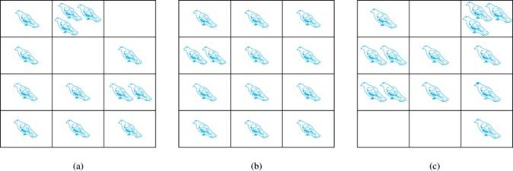
The Pigeonhole Principle 1
If a flock of 20 pigeons roosts in a set of 19 pigeonholes, one of the pigeonholes must have more than 1 pigeon.
Pigeonhole Principle: If k is a positive integer and k + 1 objects are placed into k boxes, then at least one box contains two or more objects.
Proof: We use a proof by contraposition. Suppose none of the k boxes has more than one object. Then the total number of objects would be at most k. This contradicts the statement that we have k + 1 objects.
Jump to long description

Slide 25
The Pigeonhole Principle 2
Corollary 1: A function f from a set with k + 1 elements to a set with k elements is not one-to-one.
Proof: Use the pigeonhole principle.
  Create a box for each element y in the codomain of f .
  Put in the box for y all of the elements x from the domain such that f(x) = y.
  Because there are k + 1 elements and only k boxes, at least one box has two or more elements.
Hence, f can’t be one-to-one.

Slide 26
Pigeonhole Principle
Example: Among any group of 367 people, there must be at least two with the same birthday, because there are only 366 possible birthdays.
Example (optional): Show that for every integer n there is a multiple of n that has only 0s and 1s in its decimal expansion.
Solution: Let n be a positive integer. Consider the n + 1 integers 1, 11, 111, …., 11…1 (where the last has n + 1 1s). There are n possible remainders when an integer is divided by n. By the pigeonhole principle, when each of the n + 1 integers is divided by n, at least two must have the same remainder. Subtract the smaller from the larger and the result is a multiple of n that has only 0s and 1s in its decimal expansion.

Slide 27
The Generalized Pigeonhole Principle 1
The Generalized Pigeonhole Principle: If N objects are placed into k boxes, then there is at least one box containing at least ⌈N/k⌉ objects.
Proof: We use a proof by contraposition. Suppose that none of the boxes contains more than ⌈N/k⌉ − 1 objects. Then the total number of objects is at most
where the inequality ⌈N/k⌉ < ⌈N/k⌉ + 1 has been used. This is a contradiction because there are a total of n objects.
Example: Among 100 people there are at least
⌈100/12⌉ = 9 who were born in the same month.

Slide 28
The Generalized Pigeonhole Principle 2
Example: a) How many cards must be selected from a standard deck of 52 cards to guarantee that at least three cards of the same suit are chosen?
b) How many must be selected to guarantee that at least three hearts are selected?
Solution: a) We assume four boxes; one for each suit. Using the generalized pigeonhole principle, at least one box contains at least ⌈N/4⌉ cards. At least three cards of one suit are selected if ⌈N/4⌉ ≥3. The smallest integer N such that ⌈N/4⌉ ≥3 is
N = 2 ∙ 4 + 1 = 9.
b) A deck contains 13 hearts and 39 cards which are not hearts. So, if we select 41 cards, we may have 39 cards which are not hearts along with 2 hearts. However, when we select 42 cards, we must have at least three hearts. (Note that the generalized pigeonhole principle is not used here.)

Slide 29
Permutations and Combinations
Section 6.3

Slide 30
Section Summary 3
Permutations
Combinations
Combinatorial Proofs

Slide 31
Permutations
Definition: A permutation of a set of distinct objects is an ordered arrangement of these objects. An ordered arrangement of r elements of a set is called an
r-permutation.
Example: Let S = {1,2,3}.
  The ordered arrangement 3,1,2 is a permutation of S.
  The ordered arrangement 3,2 is a 2-permutation of S.
The number of r-permutations of a set with n elements is denoted by P(n,r).
  The 2-permutations of S = {1,2,3} are 1,2; 1,3; 2,1; 2,3; 3,1; and 3,2. Hence, P(3,2) = 6.

Slide 32
A Formula for the Number of Permutations
Theorem 1: If n is a positive integer and r is an integer with 1 ≤ r ≤ n, then there are
P(n, r) = n(n − 1)(n − 2) ∙∙∙ (n − r + 1)
r-permutations of a set with n distinct elements.
Proof: Use the product rule. The first element can be chosen in n ways. The second in n − 1 ways, and so on until there are
(n − ( r − 1)) ways to choose the last element.
Note that P(n,0) = 1, since there is only one way to order zero elements.
Corollary 1: If n and r are integers with 1 ≤ r ≤ n, then

Slide 33
Solving Counting Problems by Counting Permutations 1
Example: How many ways are there to select a first-prize winner, a second prize winner, and a third-prize winner from 100 different people who have entered a contest?
Solution:
P(100,3) = 100 ∙ 99 ∙ 98 = 970,200

Slide 34
Solving Counting Problems by Counting Permutations 2
Example: Suppose that a saleswoman has to visit eight different cities. She must begin her trip in a specified city, but she can visit the other seven cities in any order she wishes. How many possible orders can the saleswoman use when visiting these cities?
Solution: The first city is chosen, and the rest are ordered arbitrarily. Hence the orders are:
7! = 7 ∙ 6 ∙ 5 ∙ 4 ∙ 3 ∙ 2 ∙ 1 = 5040
If she wants to find the tour with the shortest path that visits all the cities, she must consider 5040 paths!

Slide 35
Solving Counting Problems by Counting Permutations 3
Example: How many permutations of the letters ABCDEFGH contain the string ABC ?
Solution: We solve this problem by counting the permutations of six objects, ABC, D, E, F, G, and H.
6! = 6 ∙ 5 ∙ 4 ∙ 3 ∙ 2 ∙ 1 = 720

Slide 36
Combinations 1
Definition: An r-combination of elements of a set is an unordered selection of r elements from the set. Thus, an
r-combination is simply a subset of the set with r elements.
The number of r-combinations of a set with n distinct elements is denoted by C(n, r). The notation
is also used and is called a binomial coefficient. (We will see the notation again in the binomial theorem in Section 6.4.)
Example: Let S be the set {a, b, c, d}. Then {a, c, d} is a 3-combination from S. It is the same as {d, c, a} since the order listed does not matter.
C(4,2) = 6 because the 2-combinations of {a, b, c, d} are the six subsets {a, b}, {a, c}, {a, d}, {b, c}, {b, d}, and {c, d}.

Slide 37
Combinations 2
Theorem 2: The number of r-combinations of a set with n elements, where n ≥ r ≥ 0, equals
Proof: By the product rule P(n, r) = C(n,r) ∙ P(r,r). Therefore

Slide 38
Combinations 3
Example: How many poker hands of five cards can be dealt from a standard deck of 52 cards? Also, how many ways are there to select 47 cards from a deck of 52 cards?
Solution: Since the order in which the cards are dealt does not matter, the number of five card hands is:
The different ways to select 47 cards from 52 is
This is a special case of a general result. →

Slide 39
Combinations 4
Corollary 2: Let n and r be nonnegative integers with
r ≤ n. Then C(n, r) = C(n, n − r).
Proof: From Theorem 2, it follows that
Hence, C(n, r) = C(n, n − r).
This result can be proved without using algebraic manipulation. →

Slide 40
Combinatorial Proofs 1
Definition 1: A combinatorial proof of an identity is a proof that uses one of the following methods.
  A double counting proof uses counting arguments to prove that both sides of an identity count the same objects, but in different ways.
  A bijective proof shows that there is a bijection between the sets of objects counted by the two sides of the identity.

Slide 41
Combinatorial Proofs 2
Here are two combinatorial proofs that
when r and n are nonnegative integers with r < n:
  Bijective Proof: Suppose that S is a set with n elements. The function that maps a subset A of S to Ā is a bijection between the subsets of S with r elements and the subsets with n − r elements. Since there is a bijection between the two sets, they must have the same number of elements.
  Double Counting Proof: By definition the number of subsets of S with r elements is C(n, r). Each subset A of S can also be described by specifying which elements are not in A, i.e., those which are in Ā. Since the complement of a subset of S with r elements has n − r elements, there are also C(n, n − r) subsets of S with r elements.

Slide 42
Combinations 5
Example: How many ways are there to select five players from a 10-member tennis team to make a trip to a match at another school.
Solution: By Theorem 2, the number of combinations is
Example: A group of 30 people have been trained as astronauts to go on the first mission to Mars. How many ways are there to select a crew of six people to go on this mission?
Solution: By Theorem 2, the number of possible crews is

Slide 43
Binomial Coefficients and Identities
Section 6.4

Slide 44
Section Summary 4
The Binomial Theorem
Pascal’s Identity and Triangle
Other Identities Involving Binomial Coefficients (not currently included in overheads)

Slide 45
Powers of Binomial Expressions
Definition: A binomial expression is the sum of two terms, such as x + y. (More generally, these terms can be products of constants and variables.)
  We can use counting principles to find the coefficients in the expansion of (x + y)^{n} where n is a positive integer.
  To illustrate this idea, we first look at the process of expanding (x + y)³.
  (x + y) (x + y) (x + y) expands into a sum of terms that are the product of a term from each of the three sums.
  Terms of the form x³, x²y, x y², y³ arise. The question is what are the coefficients?
    To obtain x³ , an x must be chosen from each of the sums. There is only one way to do this. So, the coefficient of x³ is 1.
    To obtain x²y, an x must be chosen from two of the sums and a y from the other. There are
  ways to do this and so the coefficient of x²y is 3.
  To obtain xy², an x must be chosen from of the sums and a y from the other two . There are
  ways to do this and so the coefficient of xy² is 3.
  To obtain y³ , a y must be chosen from each of the sums. There is only one way to do this. So, the coefficient of y³ is 1.
  We have used a counting argument to show that (x + y)³ = x³ + 3x²y + 3x y² + y³ .
Next we present the binomial theorem gives the coefficients of the terms in the expansion of (x + y)^{n} .

Slide 46
Binomial Theorem
Binomial Theorem: Let x and y be variables, and n a nonnegative integer. Then:
Proof: We use combinatorial reasoning . The terms in the expansion of (x + y)^{n} are of the form x^{n−j}y^{j} for j = 0,1,2,…,n. To form the term x^{n−j}y^{j}, it is necessary to choose n−j xs from the n sums. Therefore, the coefficient of x^{n−j}y^{j} is
which equals

Slide 47
Using the Binomial Theorem
Example: What is the coefficient of x¹²y¹³ in the expansion of (2x − 3y)²⁵?
Solution: We view the expression as (2x +(−3y))²⁵. By the binomial theorem
Consequently, the coefficient of x¹²y¹³ in the expansion is obtained when j = 13.

Slide 48
A Useful Identity
Corollary 1: With n ≥0,
Proof (using binomial theorem): With x = 1 and y = 1, from the binomial theorem we see that:
Proof (combinatorial): Consider the subsets of a set with n elements. There are
subsets with zero elements,
with one element,
with two elements, …, and
with n elements. Therefore the total is
Since, we know that a set with n
elements has 2^{n} subsets, we conclude:

Slide 49
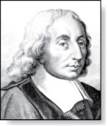
Pascal’s Identity
Pascal’s Identity: If n and k are integers with
n ≥ k ≥ 0, then
Blaise Pascal
(1623-1662)
Proof (combinatorial): Let T be a set where |T| = n + 1, a ∊T, and S = T − {a}. There are
subsets of T containing k elements.
Each of these subsets either:
  contains a with k − 1 other elements, or
  contains k elements of S and not a.
There are
  subsets of k elements that contain a, since there are
subsets of k − 1 elements of S,
  subsets of k elements of T that do not contain a, because there are
  subsets of k elements of S.
See Exercise 19 for an algebraic proof.
Hence,

Slide 50
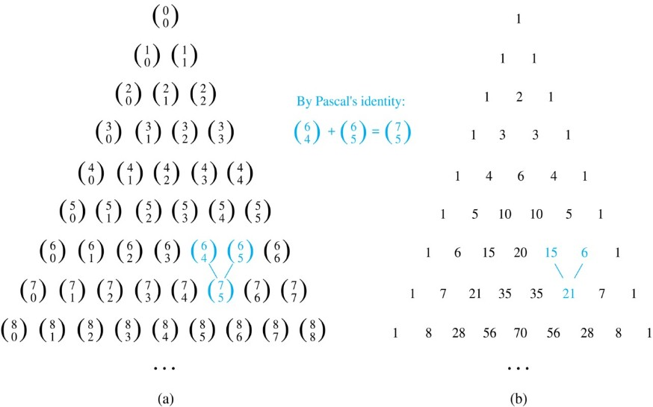
Pascal’s Triangle
The nth row in the triangle consists of the binomial coefficients
k = 0,1,….,n.
By Pascal’s identity, adding two adjacent binomial coefficients results is the binomial coefficient in the next row between these two coefficients.
Jump to long description

Slide 51
Generalized Permutations and Combinations
Section 6.5

Slide 52
Section Summary 5
Permutations with Repetition
Combinations with Repetition
Permutations with Indistinguishable Objects
Distributing Objects into Boxes

Slide 53
Permutations with Repetition
Theorem 1: The number of r-permutations of a set of n objects with repetition allowed is n^{r}.
Proof: There are n ways to select an element of the set for each of the r positions in the r-permutation when repetition is allowed. Hence, by the product rule there are n^{r} r-permutations with repetition.
Example: How many strings of length r can be formed from the uppercase letters of the English alphabet?
Solution: The number of such strings is 26^{r}, which is the number of r-permutations of a set with 26 elements.

Slide 54
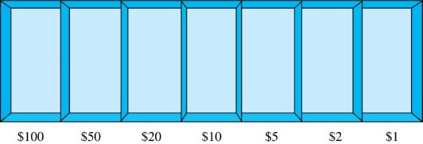
Combinations with Repetition 1
Example: How many ways are there to select five bills from a box containing at least five of each of the following denominations: $1, $2, $5, $10, $20, $50, and $100?
Solution: Place the selected bills in the appropriate position of a cash box illustrated below:

Slide 55
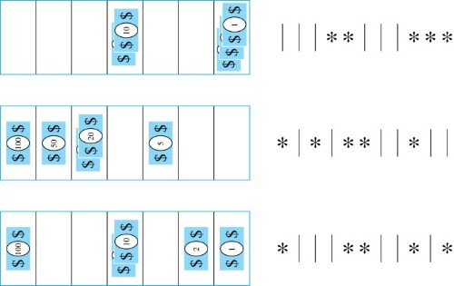
Combinations with Repetition 2
Some possible ways of placing the five bills:
The number of ways to
select five bills corresponds
to the number of ways to
arrange six bars and five stars
in a row.
This is the number of unordered
selections of 5 objects from a set of 11. Hence, there are
ways to choose five bills with seven types of bills.
Jump to long description

Slide 56
Combinations with Repetition 3
Theorem 2: The number 0f r-combinations from a set with n elements when repetition of elements is allowed is
Proof: Each r-combination of a set with n elements with repetition allowed can be represented by a list of n –1 bars and r stars. The bars mark the n cells containing a star for each time the ith element of the set occurs in the combination.
The number of such lists is C(n + r – 1, r), because each list is a choice of the r positions to place the stars, from the total of n + r – 1 positions to place the stars and the bars. This is also equal to C(n + r – 1, n –1), which is the number of ways to place the n –1 bars.

Slide 57
Combinations with Repetition 4
Example: How many solutions does the equation
have, where x₁ , x₂ and x₃ are nonnegative integers?
Solution: Each solution corresponds to a way to select 11 items from a set with three elements; x₁ elements of type one, x₂ of type two, and x₃ of type three.
By Theorem 2 it follows that there are
solutions.

Slide 58

Combinations with
Repetition 5
Example: Suppose that a cookie shop
has four different kinds of cookies. How
many different ways can six cookies be chosen?
Solution: The number of ways to choose six cookies is the number of 6-combinations of a set with four elements. By Theorem 2
is the number of ways to choose six cookies from the four kinds.

Slide 59
Summarizing the Formulas for Counting Permutations and Combinations with and without Repetition
TABLE 1 Combinations and Permutations With and Without Repetition.
Type | Repetition Allowed? | Formula
r-permutations r-combinations r-permutations r-combinations | No No Yes Yes

Slide 60
Permutations with Indistinguishable Objects 1
Example: How many different strings can be made by reordering the letters of the word SUCCESS.
Solution: There are seven possible positions for the three Ss, two Cs, one U, and one E.
  The three Ss can be placed in C(7,3) different ways, leaving four positions free.
  The two Cs can be placed in C(4,2) different ways, leaving two positions free.
  The U can be placed in C(2,1) different ways, leaving one position free.
  The E can be placed in C(1,1) way.
By the product rule, the number of different strings is:
The reasoning can be generalized to the following theorem. →

Slide 61
Permutations with Indistinguishable Objects 2
Theorem 3: The number of different permutations of n objects, where there are n₁ indistinguishable objects of type 1, n₂ indistinguishable objects of type 2, …., and n_{k} indistinguishable objects of type k, is:
Proof: By the product rule the total number of permutations is:
C(n, n₁ ) C(n − n₁, n₂ ) ∙∙∙ C(n − n₁ − n₂ − ∙∙∙ − n_{k}, n_{k}) since:
  The n₁ objects of type one can be placed in the n positions in C(n, n₁ ) ways, leaving n − n₁ positions.
  Then the n₂ objects of type two can be placed in the n − n₁ positions in C(n − n₁, n₂ ) ways, leaving n − n₁ − n₂ positions.
  Continue in this fashion, until n_{k} objects of type k are placed in C(n − n₁ − n₂ − ∙∙∙ − n_{k}, n_{k}) ways.
The product can be manipulated into the desired result as follows:

Slide 62
Distributing Objects into Boxes 1
Many counting problems can be solved by counting the ways objects can be placed in boxes.
  The objects may be either different from each other (distinguishable) or identical (indistinguishable).
  The boxes may be labeled (distinguishable) or unlabeled (indistinguishable).

Slide 63
Distributing Objects into Boxes 2
Distinguishable objects and distinguishable boxes.
  There are n!/(n₁!n₂! ∙∙∙n_{k}!) ways to distribute n distinguishable objects into k distinguishable boxes.
  (See Exercises 47 and 48 for two different proofs.)
  Example: There are 52!/(5!5!5!5!32!) ways to distribute hands of 5 cards each to four players.
Indistinguishable objects and distinguishable boxes.
  There are C(n + r − 1, n − 1) ways to place r indistinguishable objects into n distinguishable boxes.
  Proof based on one-to-one correspondence between n-combinations from a set with k-elements when repetition is allowed and the ways to place n indistinguishable objects into k distinguishable boxes.
  Example: There are C(8 + 10 − 1, 10) = C(17,10) = 19,448 ways to place 10 indistinguishable objects into 8 distinguishable boxes.

Slide 64
Distributing Objects into Boxes 3
Distinguishable objects and indistinguishable boxes.
  Example: There are 14 ways to put four employees into three indistinguishable offices (see Example 10).
  There is no simple closed formula for the number of ways to distribute n distinguishable objects into j indistinguishable boxes.
  See the text for a formula involving Stirling numbers of the second kind.
Indistinguishable objects and indistinguishable boxes.
  Example: There are 9 ways to pack six copies of the same book into four identical boxes (see Example 11).
  The number of ways of distributing n indistinguishable objects into k indistinguishable boxes equals p_{k}(n), the number of ways to write n as the sum of at most k positive integers in increasing order.
  No simple closed formula exists for this number.

Slide 65
Appendix of Image Long Descriptions

Slide 66
The Product Rule – Appendix
There are 6 gaps, 3 for letters and 3 for digits. There is a curly bracket under the gaps for letters showing that there are 26 choices for each letter. Also, there is a curly bracket under the gaps for digits showing that there are 10 choices for each digit.
Jump to the image

Slide 67
Internet Addresses – Appendix
There is a table consisting of 32 columns and 5 rows. The columns are numbered from 0 to 31, and they represent a bit number. The rows are Class A, Class B, Class C, Class D, and Class E. Bit 0 in Class A is 0. Bits 1 through 7 are labeled net ID. Bits 8 through 31 are labeled host ID. Bit 0 in Class B is 1, bit 1 is 0. Bits 2 through 15 are labeled net ID. Bits 16 through 31 are labeled host ID. Bits 0 and 1 in Class C are 1, bit 2 is 0, bits 3 through 23 are labeled net ID. Bits 24 through 31 are labeled host ID. Bits 0, 1, and 2 in Class D are 1, bit 3 is 0. Bits 4 through 31 are labeled Multicast Address. Bits 0, 1, 2, and 3 in Class D are 1. Bit 4 is 0. Bits 5 through 31 are labeled Address.
Jump to the image

Slide 68
Counting Bit Strings – Appendix
There are three lines of 8 gaps each. In the first line, the first gap is 1, and there is a curly bracket under other gaps showing that there are 2 to the seventh power equal to 128 ways to place 0 and 1 on the remaining 7 gaps. The two last gaps of the second line are 0, and there is a curly bracket under other gaps showing that there are 2 to the sixth power equal to 64 ways to place 0 and 1 on the remaining 6 gaps. The first gap of the third line is 1, two last gaps are 0. Also, there is a curly bracket under other gaps showing that there are 2 to the fifth power equal to 32 ways to place 0 and 1 on the remaining 5 gaps.
Jump to the image

Slide 69
Tree Diagrams – Appendix
The tree has a root on a basic level. The root has five branches to the vertices that labeled as S, M, L, X L, and X X L. Each of vertices S, M, and L has four branches to the vertices labeled W, R, G, and B. Vertex X L has three branches to vertices labeled R, G, and B. Vertex X X L has two branches to vertices labeled G and B.
Jump to the image

Slide 70
The Pigeonhole Principle 1 – Appendix
There are three 4 by 3 tables labeled A, B, and C. Table A. Cells 1, 3 and 2, 2 are empty. There are 3 pigeons in cell 1, 2 and 2 pigeons in cell 3, 3. All other cells have one pigeon. Table B. There are 2 pigeons in cell 1,1. All other cells have one pigeon. Table C. Cells 1, 2 and 4, 1 and 4, 2 are empty. There are 3 pigeons in cell 1, 3. There are 2 pigeons in cells 2, 1 and 3, 1. All other cells have one pigeon.
Jump to the image

Slide 71
Pascal’s Triangle – Appendix
The elements of the first triangle are binomial coefficients. The top number is the row number, and the bottom number is the column number, both starting from 0. Coefficient 0, 0 is at the top. The elements of the second triangle are natural numbers. 1 is at the top of the triangle and along the left and right edges. The numbers between them are the sums of two numbers above.
Jump to the image

Slide 72
Combinations with Repetition 2 – Appendix
The first way is 2 10 dollar bills from the fourth compartment and 3 1 dollar bills from the seventh compartment. Or 3 bars, 2 stars, 3 bars, and 3 stars. The second way is 1 100 dollar bill from the first compartment. 1 50 dollar bill from the second compartment. 2 20 dollar bills from the third compartment, and 1 5 dollar bill from the fifth compartment. Or 1 star, 1 bar, 1 star. 1 bar, 2 stars, 2 bars. 1 star, and 2 bars. The third way is 1 100 dollar bill from the first compartment. 2 10 dollar bills from the fourth compartment. 1 2 dollar bill from the sixth compartment, and 1 1 dollar bill from the seventh compartment. Or 1 star, 3 bars, 2 stars. 2 bars, 1 star, 1 bar, and 1 star.
Jump to the image

