Slide 1
3D Tracking Simulation of Orbiting Satellites
TEAM INNER ELLIPSE

Slide 2
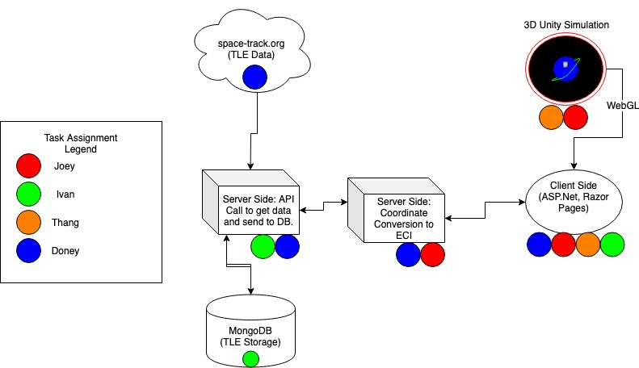
Project Assignments
Unity to create simulation experience
Space-Track.org data TLE Repository
MongoDB for Persisted TLE data
Microsoft stack for Server-Client side application.

Slide 3
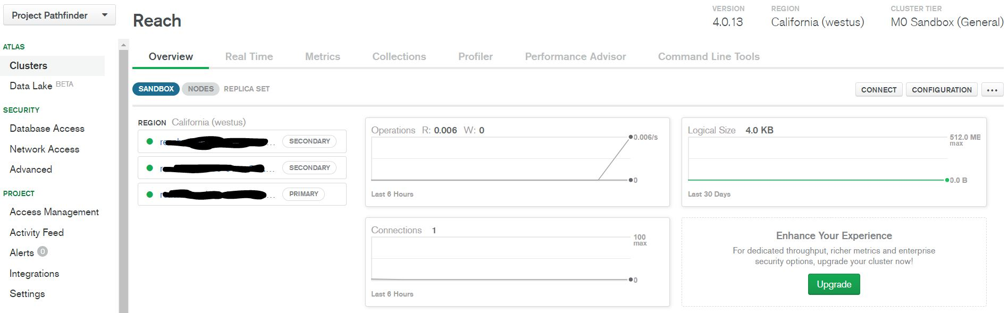
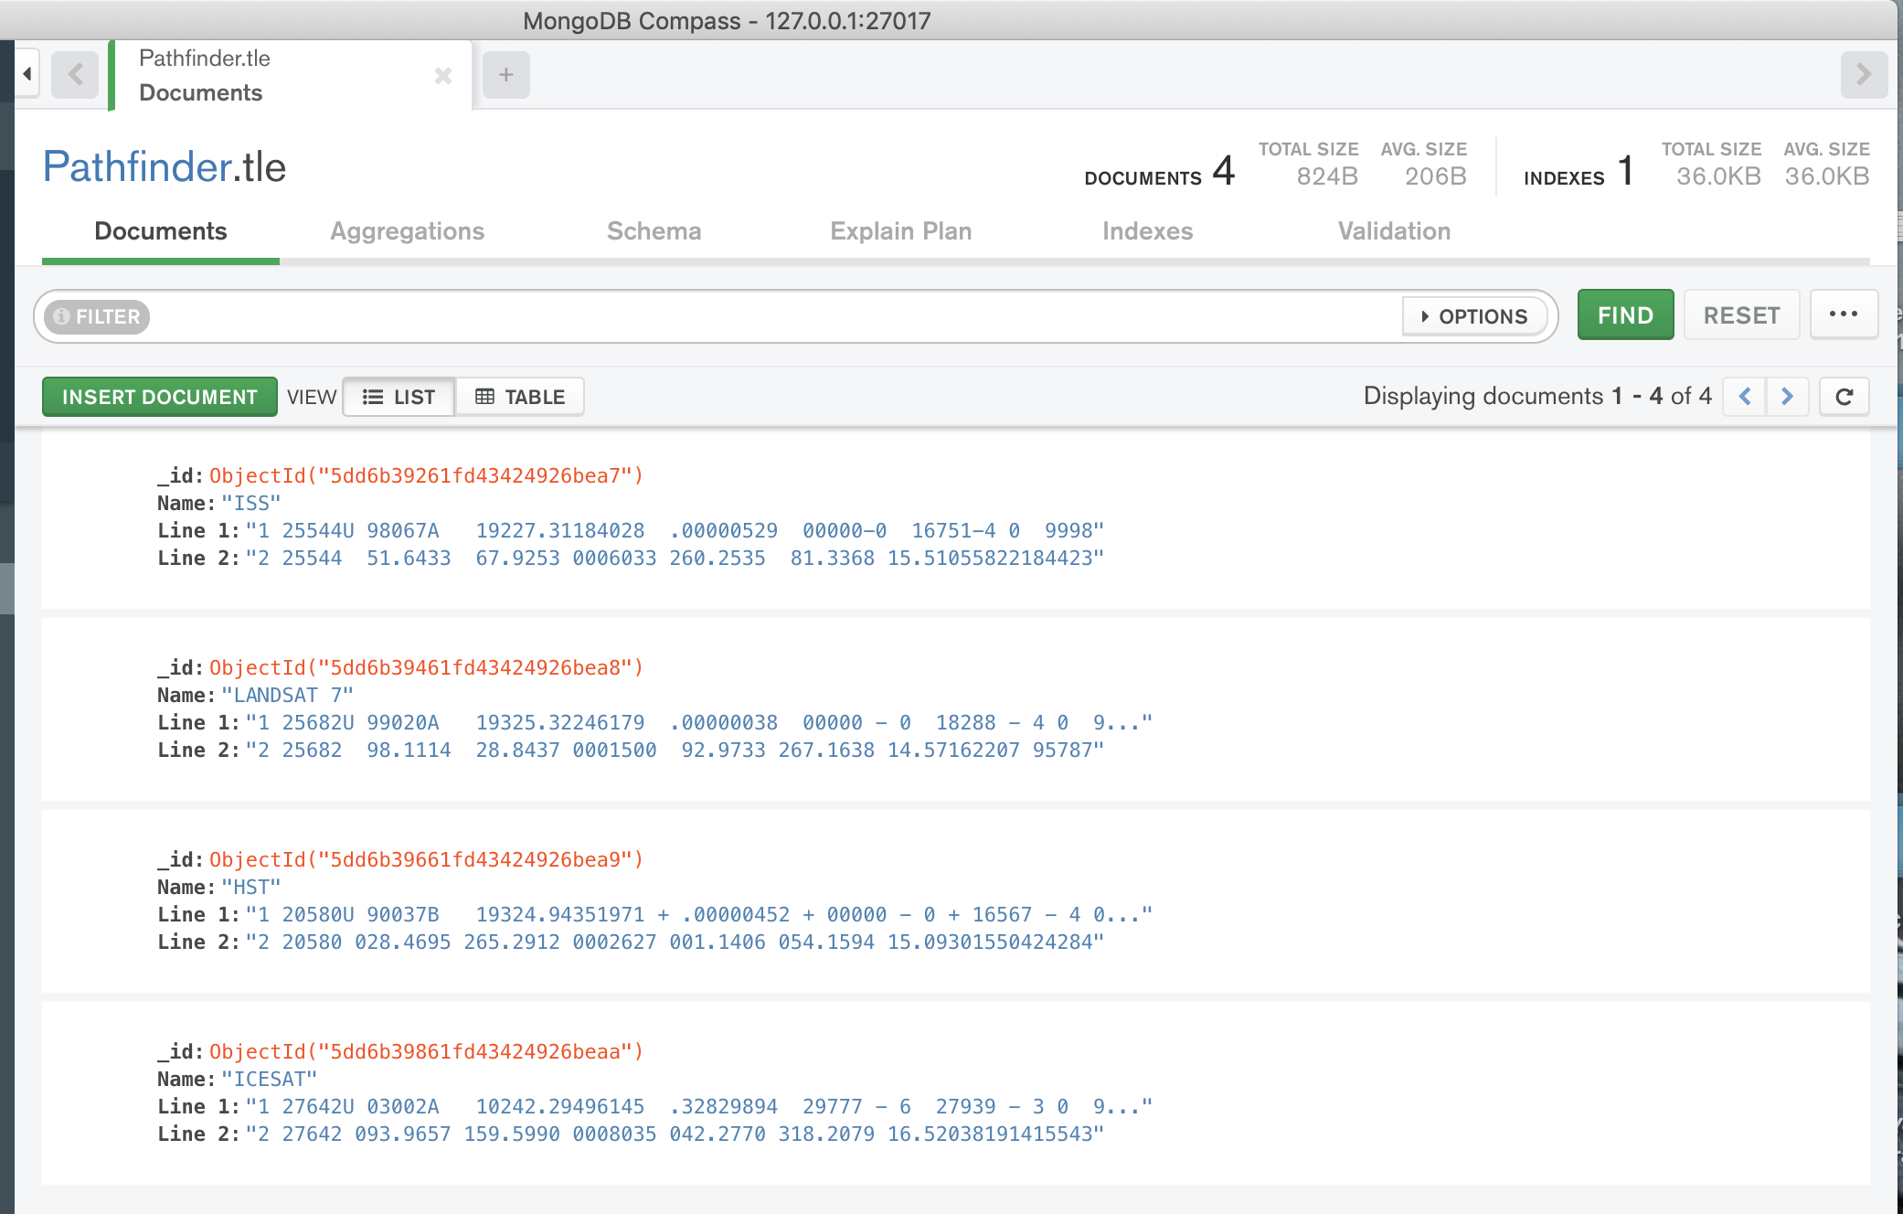
MongoDB
Document-based DBMS that stores data in JSON-like formats.
MongoDB Atlas - cloud database
MongoDB Compass - GUI

Slide 4
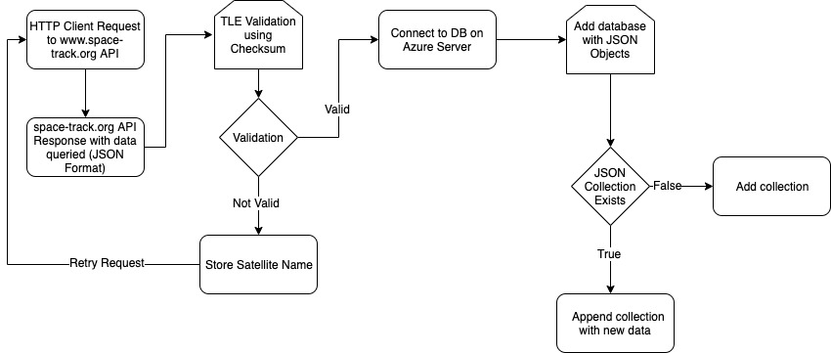
TLE Capture & Store Process
Retrieve data from spacetrack-org API as 3LE format in HTTP request body
Validate all TLE files via checksum
Call persistence method to convert 3lE formatted files to Bson format.
Insert into database.
File data will be pulled when satellite is chosen to be rendered.

Slide 5
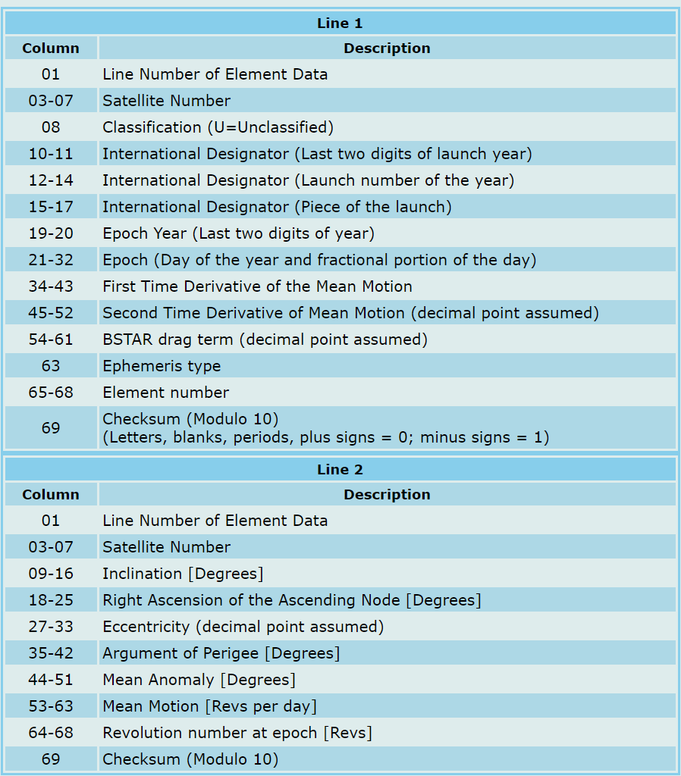
Server Side: Two-Line Elements
ISS (ZARYA)
1 25544U 98067A 19325.45514289 .00000314 00000-0 13519-4 0 9999
2 25544 51.6463 301.5620 0006288 306.4799 195.7838 15.50019269199655
Parser splices lines of string TLE data into substrings, then converted into needed variables for calculations.
SGP4 is the model used to calculate the Earth-Centered Inertial coordinates based on the TLE data.

Slide 6
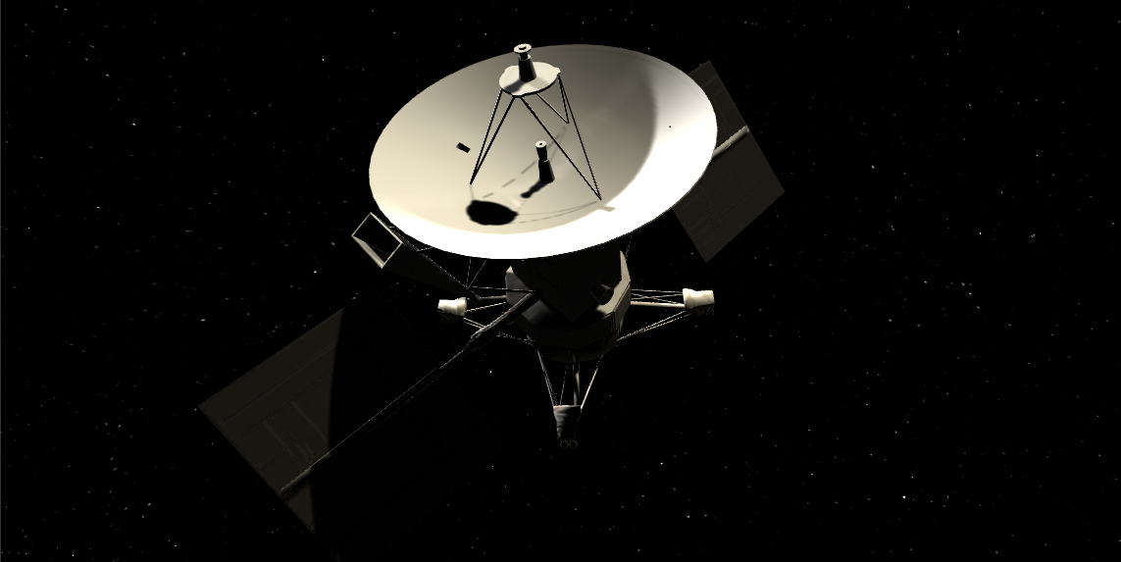
Unity webGL
3D Graphic Rendering
Interactive GUI
Physics using RidgidBody

Slide 7
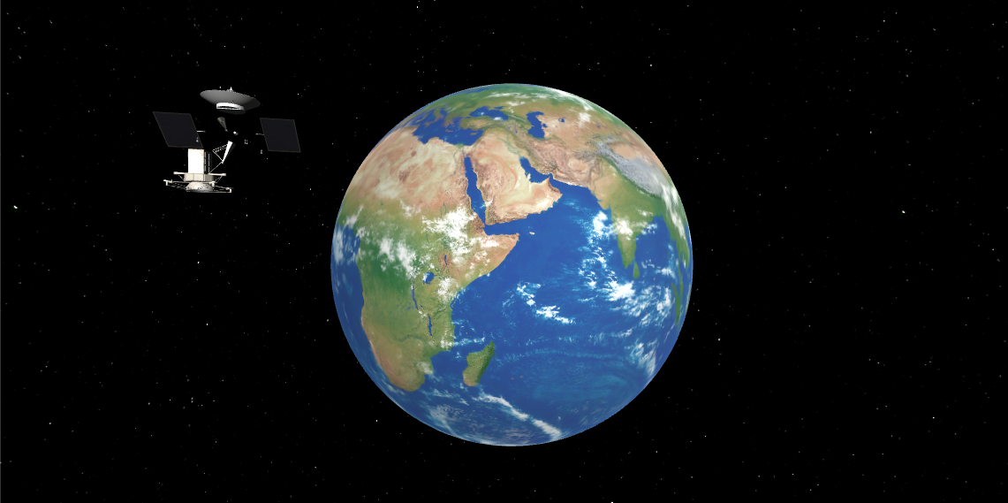

Slide 8
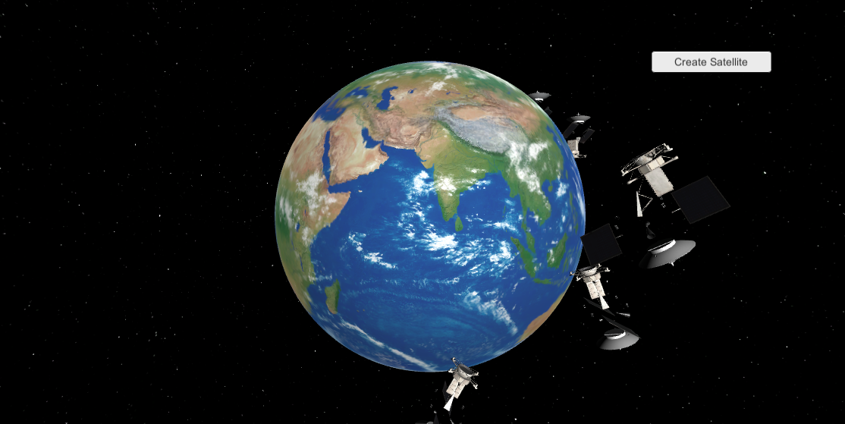

Slide 9
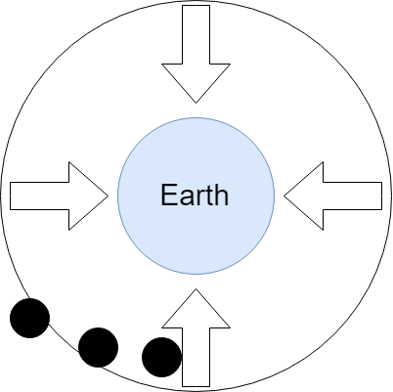

Slide 10
Demo

Slide 11
Senior Project I Timeline
-> Gathering Data/ R&D
-> Test implementations
-> Basic components completed
-> Full integration of components
-> First half of Project completed
10/01
11/07
12/05
10/24
11/21
-Project Infrastructure Design/ Delegate Tasks
-> Data Gathering Completed
-> Proof of concept with a few satellites

Slide 12
Estimated Senior Project II Timeline
-> Begin Refactoring
-> Finish persistent fetch to Space-Track
-> Preparations for Senior Expo presentation
-> Project Completion
01/03
03/19
05/20
02/06
04/20
-> Finalize achievable front-end deliverables and features
-> 2nd Reintegration of components
-> Begin final modifications
-> Maintenance and Consumer Review

