Slide 1
CMPS 3120
Algorithm Analysis
Dr. Chengwei Lei
CEECS
California State University, Bakersfield

Slide 2
Hashing

Slide 3
Before We Start

Slide 4
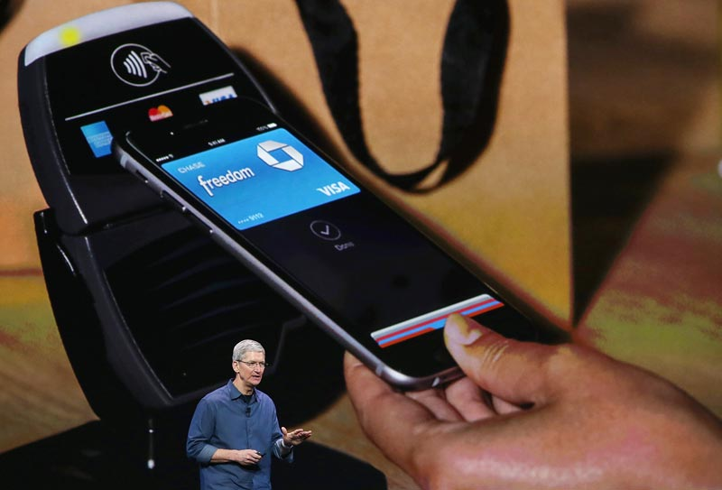

Slide 5
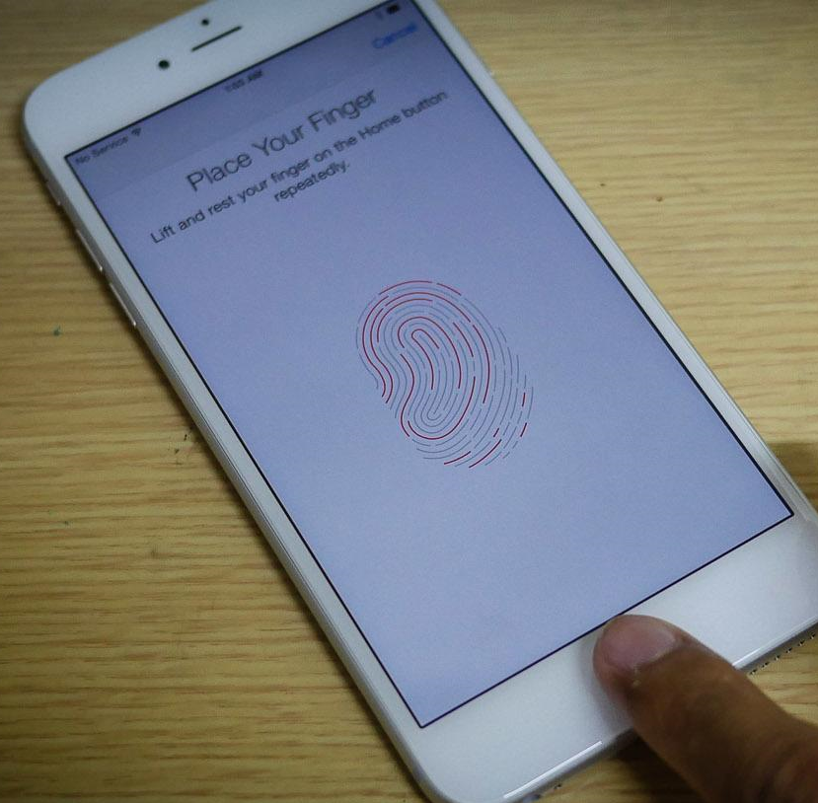

Slide 6
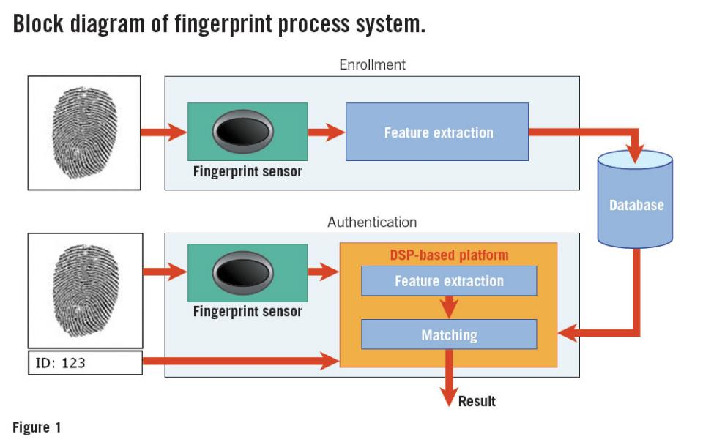

Slide 7

Fingerprint Verification

Slide 8
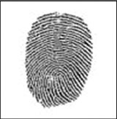
Fingerprint Verification

Slide 9

Fingerprint Verification

Slide 10

Fingerprint Verification

Slide 11
Back to Class
How to verify a computer file?
  An installation file
  A digital picture
  A digital book

Slide 12



Slide 13
=?=

Slide 14
Digital Fingerprint!

Slide 15

Digital Fingerprint!

Slide 16
Digital Fingerprint!
=?=

Slide 17
Hashing
Hashing is a method of turning some kind of data into a relatively small number that may serve as a digital "fingerprint" of the data.

Slide 18
Hashing
Hashing is a method of turning some kind of data into a relatively small number that may serve as a digital "fingerprint" of the data.
The hashing algorithm manipulates the data to create such fingerprints, called hash values.

Slide 19
A hash function is a function that:
  When applied to an Object, returns a number
  When applied to equal Objects, returns the same number for each
  When applied to unequal Objects, is very unlikely to return the same number for each

Slide 20
Hashing
Suppose we were to come up with a “magic function” that, given a value to search for, would tell us exactly where in the array to look
  If it’s in that location, it’s in the array
  If it’s not in that location, it’s not in the array

Slide 21
Example (ideal) hash function
Suppose our hash function gave us the following values:
  hashCode("apple") = 5
  hashCode("watermelon") = 3
  hashCode("grapes") = 8
  hashCode("cantaloupe") = 7
  hashCode("kiwi") = 0
  hashCode("strawberry") = 9
  hashCode("mango") = 6
  hashCode("banana") = 2
0
1
2
3
4
5
6
7
8
9
kiwi
banana
watermelon
apple
mango
cantaloupe
grapes
strawberry

Slide 22
Example (ideal) hash function
Check if “apple” is on the list
  hashCode(“apple") = ?
0
1
2
3
4
5
6
7
8
9
kiwi
banana
watermelon
apple
mango
cantaloupe
grapes
strawberry

Slide 23
Example (ideal) hash function
Check if “apple” is on the list
  hashCode(“apple") = 5
0
1
2
3
4
5
6
7
8
9
kiwi
banana
watermelon
apple
mango
cantaloupe
grapes
strawberry

Slide 24
Example (ideal) hash function
Check if “pineapple” is on the list
0
1
2
3
4
5
6
7
8
9
kiwi
banana
watermelon
apple
mango
cantaloupe
grapes
strawberry

Slide 25
Example (ideal) hash function
Check if “pineapple” is on the list
  hashCode(“pineapple") = 4
0
1
2
3
4
5
6
7
8
9
kiwi
banana
watermelon
apple
mango
cantaloupe
grapes
strawberry

Slide 26
Componets
In general, a hash table consists of two major components,
  a bucket array
    is used to store the data according to their computed indices
  a hash function,
    maps keys to positions in the hash table

Slide 27
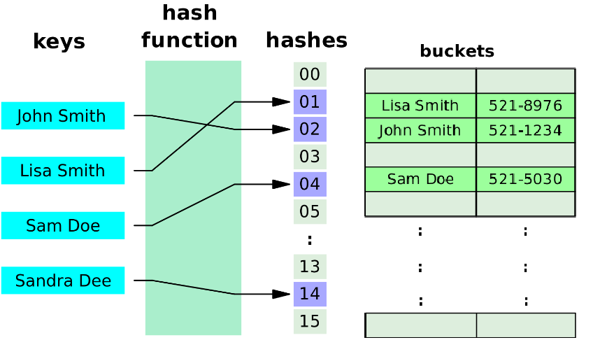

Slide 28
Hash functions are designed to be
  fast and
  yield few hash collisions in expected input domains.

Slide 29
Example
Let the hash table be an 11-element array.
If k is the key of a data record, let H(k) represent the hash function,
  where H(k) = k mod 11.
Insert the keys 83, 14, 29, 70, 10, 55:

Slide 30
Hash
0
1
2
3
4
5
6
7
8
9
10
Buckets
Keys
83
14
29
70
10
55
Hash Function
% 11

Slide 31
Hash
0
1
2
3
4
5
6
7
8
9
10
Buckets
Keys
83
14
29
70
10
55
Hash Function
% 11

Slide 32
Hash
0
1
2
3
4
5
6
7
8
9
10
Buckets
Keys
83
14
29
70
10
55
Hash Function
% 11

Slide 33
Hash
0
1
2
3
4
5
6
7
8
9
10
Buckets
83
Keys
83
14
29
70
10
55
Hash Function
% 11

Slide 34
Hash
0
1
2
3
4
5
6
7
8
9
10
Buckets
14
83
Keys
83
14
29
70
10
55
Hash Function
% 11

Slide 35
Hash
0
1
2
3
4
5
6
7
8
9
10
Buckets
14
83
29
Keys
83
14
29
70
10
55
Hash Function
% 11

Slide 36
Hash
0
1
2
3
4
5
6
7
8
9
10
Buckets
14
70
83
29
Keys
83
14
29
70
10
55
Hash Function
% 11

Slide 37
Hash
0
1
2
3
4
5
6
7
8
9
10
Buckets
14
70
83
29
10
Keys
83
14
29
70
10
55
Hash Function
% 11

Slide 38
Hash
0
1
2
3
4
5
6
7
8
9
10
Buckets
55
14
70
83
29
10
Keys
83
14
29
70
10
55
Hash Function
% 11

Slide 39
Hash
0
1
2
3
4
5
6
7
8
9
10
Buckets
55
14
70
83
29
10
Keys
83
14
29
70
10
55
Hash Function
% 11

Slide 40
Collision
If a hash function maps two keys to the same position in the hash table, then a collision occurs.

Slide 41
Hash
0
1
2
3
4
5
6
7
8
9
10
Buckets
55
14
70
83
29
10
Keys
83
14
29
70
10
55
72
Hash Function
% 11

Slide 42
Hash
0
1
2
3
4
5
6
7
8
9
10
Buckets
55
14
70
83
29
10
Keys
83
14
29
70
10
55
72
Hash Function
% 11

Slide 43
Hash
0
1
2
3
4
5
6
7
8
9
10
Buckets
55
14
70
???????
29
10
Keys
83
14
29
70
10
55
72
Hash Function
% 11

Slide 44
Collision
For any hashing problem of reasonable size, we are almost certain to have collisions.

Slide 45
Example
Let k be a birthday.
  Hash each birthday into a table of size 365 (one cell for each day of the year).
36 students in this class
  What is the chance of having at least one collision.

Slide 46
Example
Let k be a birthday.
  Hash each birthday into a table of size 365 (one cell for each day of the year).
Probability that n people don’t have the same
  birthday: p = (364/365)*(363/365)*...*((365-n+1)/365)
    When n > 36, p < 0.167.
    This means when n > 36, we have 83.3% chances that at least two people share the same birthday!

Slide 47
Solutions for Collision
Linear Probing
  During insert of key k to position p:
    If position p contains a different key, then examine positions p+1, p+2, etc.* until an empty position is found and insert k there.
  During a search for key k at position p:
    If position p contains a different key, then examine positions p+1, p+2, etc.* until either the key is found or an unused position is encountered.

Slide 48
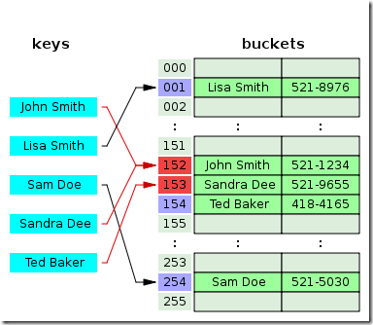

Slide 49
Linear Probing
Hash
0
1
2
3
4
5
6
7
8
9
10
Buckets
55
14
70
83
29
10
Keys
83
14
29
70
10
55
72
Hash Function
% 11

Slide 50
Linear Probing
Hash
0
1
2
3
4
5
6
7
8
9
10
Buckets
55
14
70
83
29
10
Keys
83
14
29
70
10
55
72
Hash Function
% 11

Slide 51
Linear Probing
Hash
0
1
2
3
4
5
6
7
8
9
10
Buckets
55
14
70
83
29
10
Keys
83
14
29
70
10
55
72
Hash Function
% 11

Slide 52
Linear Probing
Hash
0
1
2
3
4
5
6
7
8
9
10
Buckets
55
14
70
83
29
72
10
Keys
83
14
29
70
10
55
72
Hash Function
% 11

Slide 53
Linear Probing
Hash
0
1
2
3
4
5
6
7
8
9
10
Buckets
55
14
70
83
29
72
10
Keys
83
14
29
70
10
55
72
Hash Function
% 11
New Keys
36
69

Slide 54
Linear Probing
Hash
0
1
2
3
4
5
6
7
8
9
10
Buckets
55
14
70
83
29
72
10
Keys
83
14
29
70
10
55
72
Hash Function
% 11
New Keys
36
69

Slide 55
Linear Probing
Hash
0
1
2
3
4
5
6
7
8
9
10
Buckets
55
14
70
36
83
29
72
10
Keys
83
14
29
70
10
55
72
Hash Function
% 11
New Keys
36
69

Slide 56
Linear Probing
Hash
0
1
2
3
4
5
6
7
8
9
10
Buckets
55
14
70
36
83
29
72
10
Keys
83
14
29
70
10
55
72
Hash Function
% 11
New Keys
36
69

Slide 57
Linear Probing
Hash
0
1
2
3
4
5
6
7
8
9
10
Buckets
55
14
70
36
83
29
72
69
10
Keys
83
14
29
70
10
55
72
Hash Function
% 11
New Keys
36
69

Slide 58
Linear Probing
A potential problem with linear probing is clustering, where collisions that are resolved with linear probing cause groups of consecutive locations in the hash table to be occupied.

Slide 59
Chained Hashing
A simple and efficient way for dealing with collisions is to have each bucket A[i] store a list of (k, v) pairs with h(k) = i.
We can store more elements than the table size by using chained hashing.
  Each array position in the hash table is a head reference to a linked list of keys (a "bucket").
  All colliding keys that hash to an array position are inserted to that bucket.

Slide 60
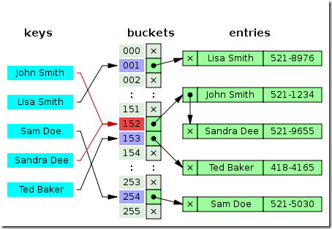

Slide 61
Chaining
Hash
0
1
2
3
4
5
6
7
8
9
10
Buckets
Null
Null
Null
Null
Null
Null
Null
Null
Null
Null
Null
Keys
83
14
29
70
10
55
72
36
69
Hash Function
% 11

Slide 62
Chaining
Hash
0
1
2
3
4
5
6
7
8
9
10
Buckets
55/Null
Null
Null
14/Null
70/Null
Null
83/Null
29/Null
Null
Null
10/Null
Keys
83
14
29
70
10
55
72
36
69
Hash Function
% 11

Slide 63
Chaining
Hash
0
1
2
3
4
5
6
7
8
9
10
Buckets
55/Null
Null
Null
14/Null
70/Null
Null
83/Null
29/Null
Null
Null
10/Null
Keys
83
14
29
70
10
55
72
36
69
Hash Function
% 11

Slide 64
Chaining
Hash
0
1
2
3
4
5
6
7
8
9
10
Buckets
55/Null
Null
Null
14/Null
70/Null
Null
83
29/Null
Null
Null
10/Null
Keys
83
14
29
70
10
55
72
36
69
Hash Function
% 11
72
Null

Slide 65
Chaining
Hash
0
1
2
3
4
5
6
7
8
9
10
Buckets
55/Null
Null
Null
14/Null
70/Null
Null
83
29/Null
Null
Null
10/Null
Keys
83
14
29
70
10
55
72
36
69
Hash Function
% 11
72
Null

Slide 66
Chaining
Hash
0
1
2
3
4
5
6
7
8
9
10
Buckets
55/Null
Null
Null
14
70/Null
Null
83
29/Null
Null
Null
10/Null
36
Null
Keys
83
14
29
70
10
55
72
36
69
Hash Function
% 11
72
Null

Slide 67
Chaining
Hash
0
1
2
3
4
5
6
7
8
9
10
Buckets
55/Null
Null
Null
14
70/Null
Null
83
29/Null
Null
Null
10/Null
36
Null
Keys
83
14
29
70
10
55
72
36
69
Hash Function
% 11
72
Null

Slide 68
Chaining
Hash
0
1
2
3
4
5
6
7
8
9
10
Buckets
55/Null
Null
Null
14
70/Null
Null
83
29/Null
Null
Null
10/Null
36
Keys
83
14
29
70
10
55
72
36
69
Hash Function
% 11
69
Null
72
Null

Slide 69
Number of Key comparison for a Successful Search
Largest
Average

Slide 70
The End

Slide 71
Hash Codes for Strings

Slide 72
Hash Codes for Strings
Each character in a string has a unicode (int) value.
    'A'=65 'B'=66 'C'=67, ..., 'a'=97, 'b'=98, 'c'=99, ...

Slide 73
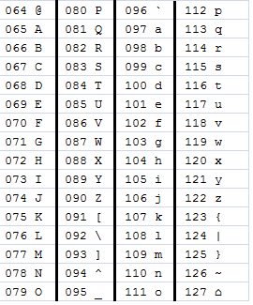
Hash Codes for Strings
Summing up
  Act=?

Slide 74
Hash Codes for Strings
Summing up
  Act=65+99+116=280

Slide 75
Hash Codes for Strings
Summing up
  Act=65+99+116=280
  Boy=66+111+121=298

Slide 76
Hash Codes for Strings
Summing up
  Act=65+99+116=280
  Boy=66+111+121=298
  Cat=?
  Ads=?

Slide 77
Hash Codes for Strings
Summing up
  Act=65+99+116=280
  Boy=66+111+121=298
  Cat=280
  Ads=280

Slide 78
Hash Codes for Strings
  Summing up the int values of the characters can lead to a lot of collisions.

Slide 79
Hash functions are designed to be
  fast and
  yield few hash collisions in expected input domains.

Slide 80
Hash Codes for Strings
Polynomial hash codes
  We choose a nonzero constant, a != 1, and calculate (x₀a^{k-1}+ x₁a^{k-2}+ ...+ x_{k-2}a+ x_{k-1}) as the hash code, ignoring overflows
  By using the Horner's rule, default a = 31

Slide 81
Hash Codes for Strings
Formular
      h = s[0]*31^{k–1} + … + s[k-3]*31² + s[k–2]*31¹ + s[k–1]*31⁰

Slide 82
Hash Codes for Strings
Formular
      h = s[0]*31^{k–1} + … + s[k-3]*31² + s[k–2]*31¹ + s[k–1]*31⁰
“Cal”

Slide 83
Hash Codes for Strings
Formular
      h = s[0]*31^{k–1} + … + s[k-3]*31² + s[k–2]*31¹ + s[k–1]*31⁰
“Cal”
  67·31² + 97·31¹ + 108·31⁰ = 67502

Slide 84
“CalStateBakersfield”

Slide 85
int GetHashCode(string str)
{
int hash = 0;
for (int i = 0; i < str.length(); i++)
{
hash = str[i] + (31 * hash);
}
return hash;
}

Slide 86
String: "Act" "Cat" "Ads"
hashcode: 65650 67510 67602

Slide 87
Hash functions are designed to be
  fast and
  yield few hash collisions in expected input domains.

