Slide 1
Decrease-and-Conquer
Reduce problem instance to smaller instance of the same problem
Solve smaller instance
Extend solution of smaller instance to obtain solution to original instance
Can be implemented either top-down or bottom-up
Also referred to as inductive or incremental approach

Slide 2
3 Types of Decrease and Conquer
Decrease by a constant (usually by 1):
insertion sort
topological sorting
algorithms for generating permutations, subsets
Decrease by a constant factor (usually by half)
binary search and bisection method
exponentiation by squaring
multiplication à la russe
Variable-size decrease
Euclid’s algorithm
selection by partition
Nim-like games

Slide 3
What’s the difference?
Consider the problem of exponentiation: Compute a^{n}
Brute Force:
Divide and conquer:
Decrease by one:
Decrease by constant factor:
Notes:
Try to get the students involved in coming up with these:
Brute Force:
a^{n}= a*a*a*a*...*a
n
Divide and conquer:
a^{n}= a^{n/2} * a^{n/2} (more accurately, a^{n}= a^{⎣n/2⎦} * a ^{⎡n/2│})
Decrease by one:
a^{n}= a^{n-1}* a (one hopes a student will ask what is the difference with brute force here:
there is none in the resulting algorithm, of course, but you can arrive
at it in two different ways)
Decrease by constant factor:
a^{n}= (a^{n/2})² (again, if no student asks about it, be sure to point out the difference
with divide and conquer. Here there is a significant difference that leads to a
much more efficient algorithm – in divide and conquer we recompute a^{n/2}

Slide 4
Insertion Sort
To sort array A[0..n-1], sort A[0..n-2] recursively and
then insert A[n-1] in its proper place among the sorted
A[0..n-2]
Usually implemented bottom up (nonrecursively)
Example: Sort 6, 4, 1, 8, 5 6 | 4 1 8 5
4 6 | 1 8 5
1 4 6 | 8 5
1 4 6 8 | 5
1 4 5 6 8

Slide 5
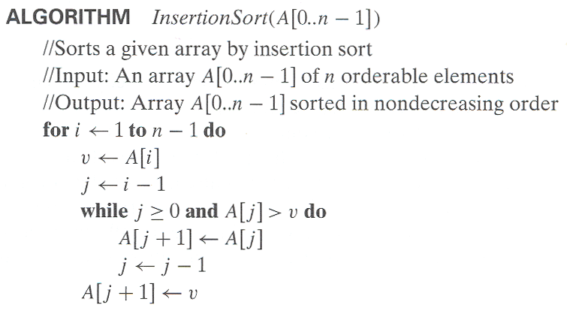
Pseudocode of Insertion Sort

Slide 6
Analysis of Insertion Sort
Time efficiency
C_{worst}(n) = n(n-1)/2 ∈ Θ(n²)
C_{avg}(n) ≈ n²/4 ∈ Θ(n²)
C_{best}(n) = n - 1 ∈ Θ(n) (also fast on almost sorted arrays)
Space efficiency: in-place
Stability: yes
Best elementary sorting algorithm overall
Binary insertion sort

Slide 7
Dags and Topological Sorting
A dag: a directed acyclic graph, i.e. a directed graph with no (directed) cycles
Arise in modeling many problems that involve prerequisite
constraints (construction projects, document version control)
Vertices of a dag can be linearly ordered so that for every edge its starting vertex is listed before its ending vertex (topological sorting). Being a dag is also a necessary condition for topological sorting be possible.
a
b
a
b
a dag
not a dag
c
d
c
d

Slide 8
Topological Sorting Example
Order the following items in a food chain
tiger
human
fish
sheep
shrimp
plankton
wheat

Slide 9
DFS-based Algorithm
DFS-based algorithm for topological sorting
Perform DFS traversal, noting the order vertices are popped off the traversal stack
Reverse order solves topological sorting problem
Back edges encountered?→ NOT a dag!
Example:
Efficiency:
a
b
c
d
e
f
g
h

Slide 10
Source Removal Algorithm
Source removal algorithm
Repeatedly identify and remove a source (a vertex with no incoming edges) and all the edges incident to it until either no vertex is left (problem is solved) or there is no source among remaining vertices (not a dag)
Example:
Efficiency: same as efficiency of the DFS-based algorithm
a
b
c
d
e
f
g
h

