Slide 1
CMPS 3120
Algorithm Analysis
Dr. Chengwei Lei
CEECS
California State University, Bakersfield

Slide 2
The course
Instructor: Dr. Chengwei Lei
Office: Science III 339
Phone: (661) 654-2102
E-mail: clei@csub.edu

Slide 3
About Me
LEI, Chengwei (雷程炜) received his Ph.D. in July 2014 from the Department of Computer Science in The University of Texas at San Antonio
His research interests lie in the broad area of bioinformatics, large scale data mining, network topology analysis, and clustering problems.

Slide 4
Course Description
Analysis of the performance of algorithms;
discussion of programming techniques and data structures used in the writing of effective algorithms.

Slide 5
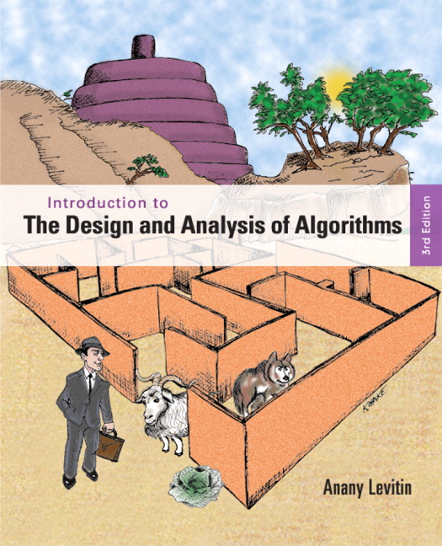
Textbook
Introduction to the Design and Analysis of Algorithms 3rd Edition,
Anany Levitin, Pearson, 2011.

Slide 6
Method of Instruction
Lecture; Demonstration; Lab

Slide 7
Semester Grade
Average of Regular Semester Exams | 30% | Exams
Homework & Labs | 50% | As determined by instructor
Comprehensive Final Exam | 20% | Comprehensive Exam

Slide 8
Late homework submissions
Each assignment is due at the specified date at the specified time. Late submissions will be accepted at a penalty of 20% for each day the assignment is late.

Slide 9
Cheating
You are not allowed to read, copy, or rewrite the solutions written by others (in this or previous terms). Copying materials from websites, books or any other sources is considered equivalent to copying from another student.
If two people are caught sharing solutions, then both the copier and copiee will be held equally responsible, which will result in zero point in homework.
Cheating on an exam will result in failing the course.

Slide 10
Getting answers from the internet is
CHEATING
Getting answers from your friends is
CHEATING
I will send it to the Dean!
You will be nailed!

Slide 11
Do NOT get answers
from others!
Discuss ideas verbally at a high-level but write up on your own.

Slide 12
To do well you should:
Study with pen and paper
Ask for help immediately
Practice, practice, practice…
Follow along in class rather than take notes
Ask questions in class
Keep up with the class
Read the book, not just the slides

Slide 13
Please feel free
to ask questions!
Help me know what people
are not understanding
We do have a lot of material
It’s your job to slow me down

Slide 15
So you want to be a computer scientist?

Slide 16
Is your goal to be a mundane programmer?

Slide 17
Or a great leader and thinker?

Slide 19
Boss assigns task:
  Given today’s prices of pork, grain, sawdust, …
  Given constraints on what constitutes a hotdog.
  Make the cheapest hotdog.
Everyday industry asks these questions.

Slide 20
Your answer:
Um? Tell me what to code.
With more sophisticated software engineering systems,
the demand for mundane programmers will diminish.

Slide 21
Your answer:
I learned this great algorithm that will work.
Soon all known algorithms
will be available in libraries.
Your boss might change his mind. He now wants to make the most profitable hotdogs.

Slide 22
Your answer:
I can develop a new algorithm for you.
Great thinkers
will always be needed.

Slide 23
How do I become a great thinker?
Maybe I’ll never be…

Slide 24
Learn from the classical problems

Slide 26

Shortest path
end
Start

Slide 27
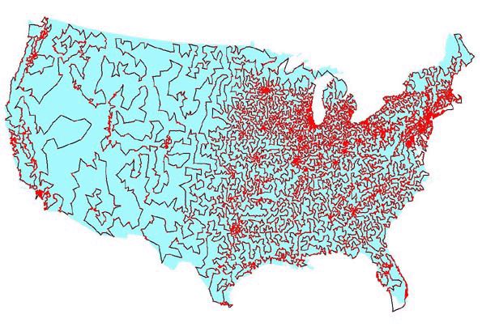

Traveling salesman problem

Slide 28
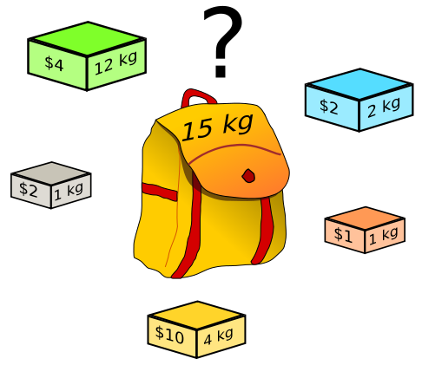
Knapsack problem

Slide 29
There is only a handful of classical problems.
  Nice algorithms have been designed for them
If you know how to solve a classical problem (e.g., the shortest-path problem), you can use it to do a lot of different things
  Abstract ideas from the classical problems
  Map your boss’ requirement to a classical problem
  Solve with classical algorithms
  Modify it if needed

Slide 30
What if you can NOT map your boss’ requirement to any existing classical problem?
How to design an algorithm by yourself?
Learn some meta algorithms
  A meta algorithm is a class of algorithms for solving similar abstract problems
  There is only a handful of them
    E.g. divide and conquer, greedy algorithm, dynamic programming
  Learn the ideas behind the meta algorithms
    Design a concrete algorithm for your task

Slide 31
What is an algorithm?

Slide 32
What is an algorithm?
An algorithm is a sequence of unambiguous instructions for solving a problem, i.e., for obtaining a required output for any legitimate input in a finite amount of time.
problem
algorithm
“computer
input
output

Slide 33
What is an algorithm?
Algorithms are the ideas behind computer programs.
An algorithm is the thing that stays the same regardless of programming language and the computing hardware

Slide 34
What is an algorithm? (cont’)
An algorithm is a precise and unambiguous specification of a sequence of steps that can be carried out to solve a given problem or to achieve a given condition.
An algorithm accepts some value or set of values as input and produces a value or set of values as output.
Algorithms are closely intertwined with the nature of the data structure of the input and output values

Slide 35
How to express algorithms?
Increasing precision
Nature language (e.g. English)
Pseudocode
Real programming languages
Ease of expression
Describe the ideas of an algorithm in nature language.
Use pseudocode to clarify sufficiently tricky details of the algorithm.

Slide 36
How to express algorithms?
Increasing precision
Nature language (e.g. English)
Pseudocode
Real programming languages
Ease of expression
To understand / describe an algorithm:
Get the big idea first.
Use pseudocode to clarify sufficiently tricky details

Slide 37
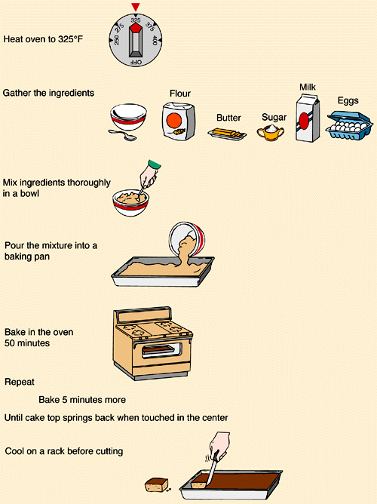
What is a program?
How to cook?
The algorithm
Are you a programmer?

Slide 38
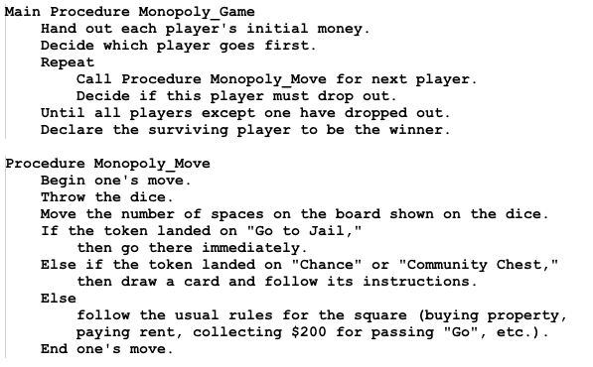
Pseudocode
This is the pseudocode for a game of Monopoly

Slide 39
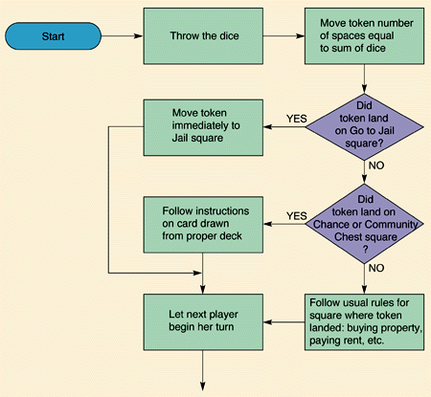
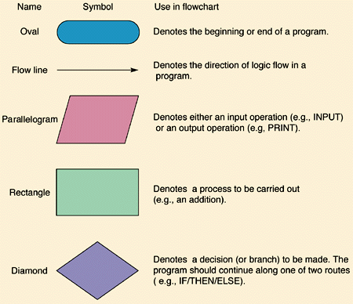
Flowcharts

Slide 40
Hey Jude
"Hey Jude" is a song by the English rock band the Beatles, written by Paul McCartney and credited to Lennon–McCartney.

Slide 41
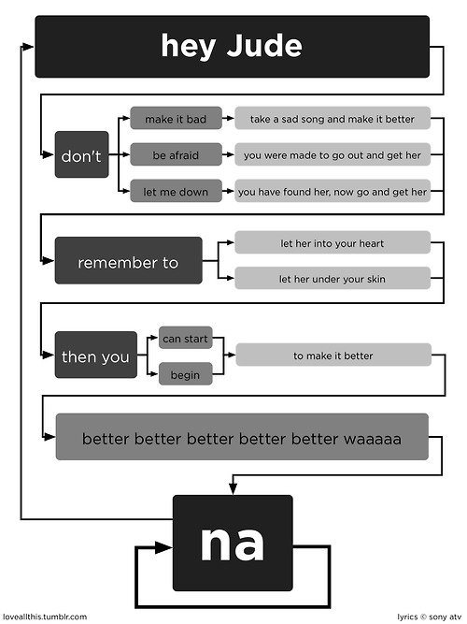

Slide 42
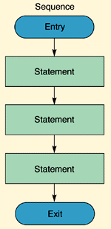
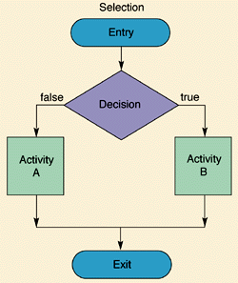
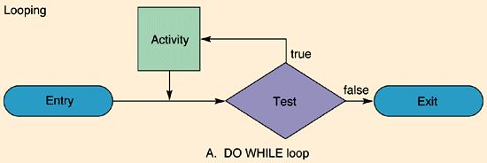
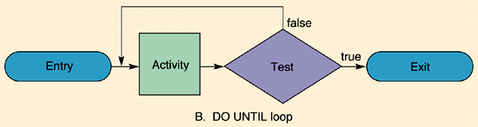
Flowcharts details

